Slide 1

Understanding the Delivery Delay of Addressed Issues in Large Software Projects
Candidate: Daniel Alencar da Costa
Advisors: Uirá Kulesza and Ahmed E. Hassan

Slide 2



Attracting and retaining the interest of users is a key factor for a software project’s success
Motivation
1

Slide 3

Within a globalized world, it is common to see globally spread teams
Motivation
2

Slide 4



Such teams use Issue Tracking Systems control the progress of their tasks
Motivation
3

Slide 5



A software issue can either describe a bug, an enhancement, or a new feature
Motivation
Bug fix
New feature
Enhancement
4

Slide 6


The state of an issue changes from ‘reported’ to ‘fixed’ as it progresses until delivery
Motivation
Reported
Fixed
5

Slide 7

Although an issue has been addressed, users may still wait some time to experience it
Problem
User
Reported
Fixed
Still…
6

Slide 8
Although an issue has been addressed, users may still wait some time to experience it
Problem
User
Reported
Fixed
Delivered!
6

Slide 9

Much effort has been invested on studying the needed time to address an issue
Current limitations
7
Notes:
Mencionar um ou outro que sejam os mais proximos do trabalho. Ver se vale a pena encaixar Outra possibilidade é deixar pro final e falar de related work (botar pro final no slide de related work é melhor)

Slide 10

However, studying the required time to deliver addressed issues remains as an open challenge
Current limitations
8

Slide 11
Agenda
Thesis
Proposal
Background
Studies
Final Remarks
9

Slide 12
We perform three studies towards the general question: what leads to delivery delay?
Thesis proposal
Quantitative
Study 1: How frequent is delivery delay?
Study 2: Do rapid releases reduce delivery delays?
Reasons
For
Delay
Impact of
Release
Strategies
Study 3: Why do delivery delays occur?
Qualitative
10
Notes:
Vale a pena ocupar um espaço maior nos slides

Slide 13
Agenda
Thesis
Proposal
Background
Studies
Final Remarks
11

Slide 14

We study different types of delivery delay
Background
12

Slide 15



Type 1 – the number of releases that are shipped before an issue is delivered
Background
Delivered after one release
1.0
2.0
3.0
13

Slide 16
Type 2 – the number of days that are required to ship an addressed issue
Background
65 days
1.0
2.0
3.0
14

Slide 17
Type 3 – the most prolonged delays of a given project
Background
Prolonged!
300
100
MAD
Median
50
0
IDs
15

Slide 18
Release cycle: is the time period that the development team takes to ship a new release
Background
Release Cycle I
Release Cycle II
1.0
2.0
3.0
16

Slide 19
Agenda
Thesis
Proposal
Background
Studies
Final Remarks
16

Slide 20

How frequent is delivery delay?
Study 1

Slide 21

There is a lack of empirical research that investigate the frequency of delivery delays
Motivation
We must have more evidences…
18

Slide 22

This study is also motivated by investigating the factors that lead to prolonged delays
Motivation
It would be very useful if we could avoid prolonged delays
19

Slide 23



We set out to empirically study 20.995 addressed issues from the Firefox, ArgoUML, and Eclipse projects
Empirical study
Firefox
Eclipse
ArgoUML
20

Slide 24



We perform the following analyses
Empirical Study
Frequency
Explore factors
Prolonged delays
21

Slide 25
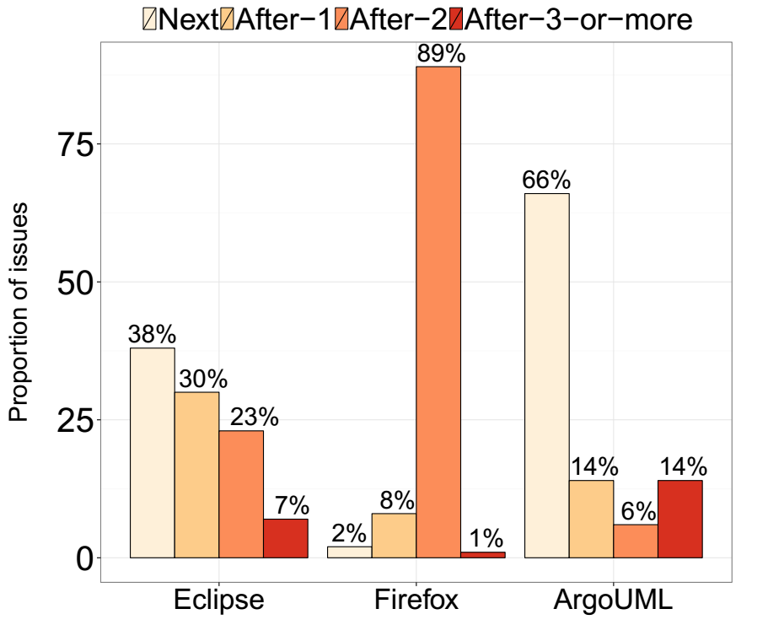
34% to 98% of addressed issues had their integration prevented from at least one release
RQ1 – How often are addressed issues prevented from shipping?
60%
22

Slide 26
34% to 98% of addressed issues had their integration prevented from at least one release
RQ1 – How often are addressed issues prevented from shipping?
34%
22

Slide 27
Issues are being addressed well before an upcoming release
RQ1 – How often are addressed issues prevented from shipping?
# of days before a release
Fix Timing
release cycle duration
23

Slide 28
Issues are being addressed well before an upcoming release
RQ1 – How often are addressed issues prevented from shipping?
30 days
Fix Timing
0.5
60 days
23

Slide 29
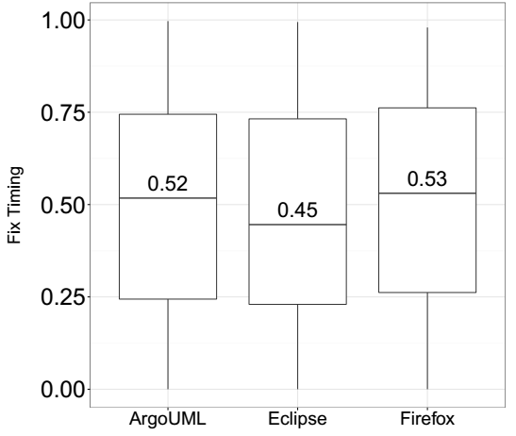
Issues are being addressed well before an upcoming release
RQ1 – How often are addressed issues prevented from shipping?
24

Slide 30
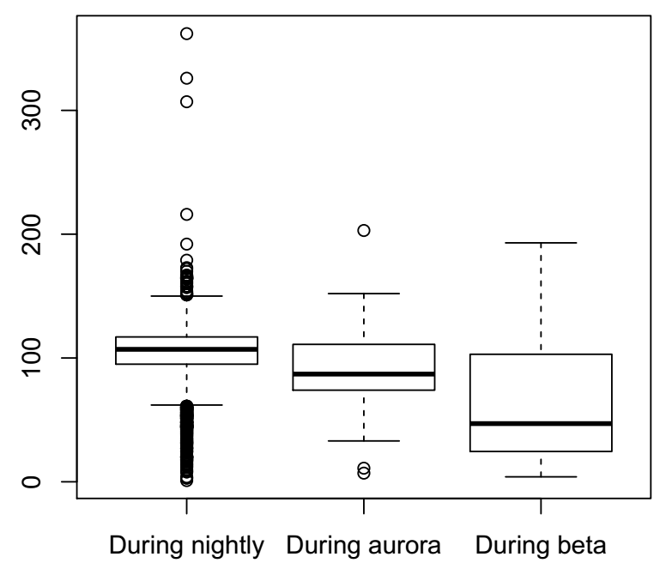
Issues that are addressed during more stable stages of a release cycle tends to have shorter delays
RQ2 – Does the stage of the release cycle impact delivery delay?
26

Slide 31
Empirical Study
Frequency
Explore factors
Prolonged delays
Indeed, delivery delay is frequent
27

Slide 32




We collect many factors that are computed using code repositories and issue tracking systems
RQ3 – How well can we model the delivery delay of addressed issues?
Number of Impacted Files
Number of comments
Experience of the resolvers
I Think this bug is due to…
VS
28

Slide 33
Then, we analyze both delivery delay in terms of number of releases and days
RQ3 – How well can we model the delivery delay of addressed issues?
AUCs
0.62 – 0.96
0.39 – 0.65
R²
29

Slide 34
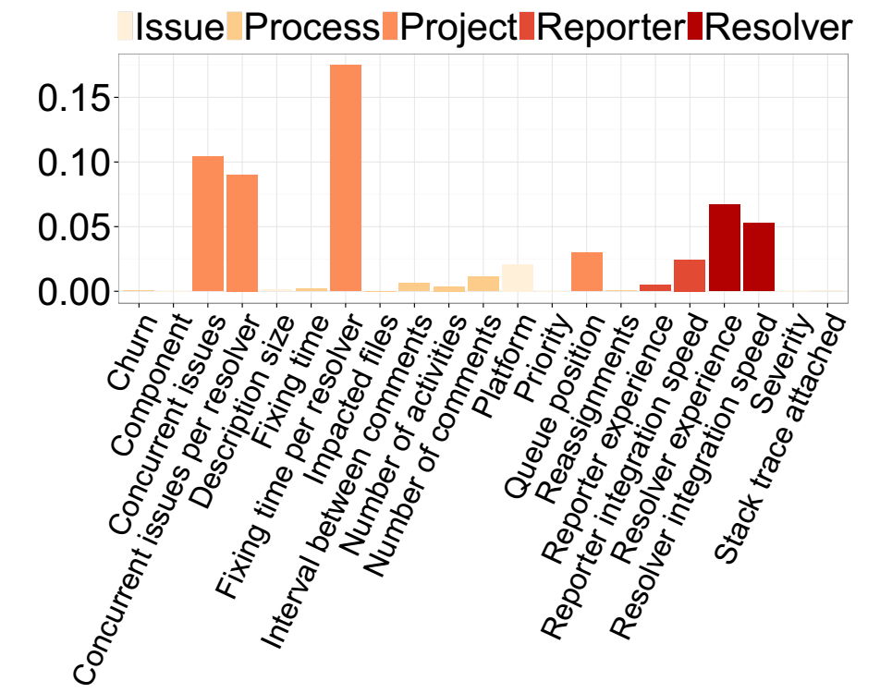
The time invested on addressing issues and workload factors play an influential role to model delay in terms of releases
RQ4 – What are the most influential factors for modeling delivery delay?
30

Slide 35
Severity and priority levels have little influence on the delivery delay in terms of releases
RQ4 – What are the most influential factors for modeling delivery delay?
31

Slide 36
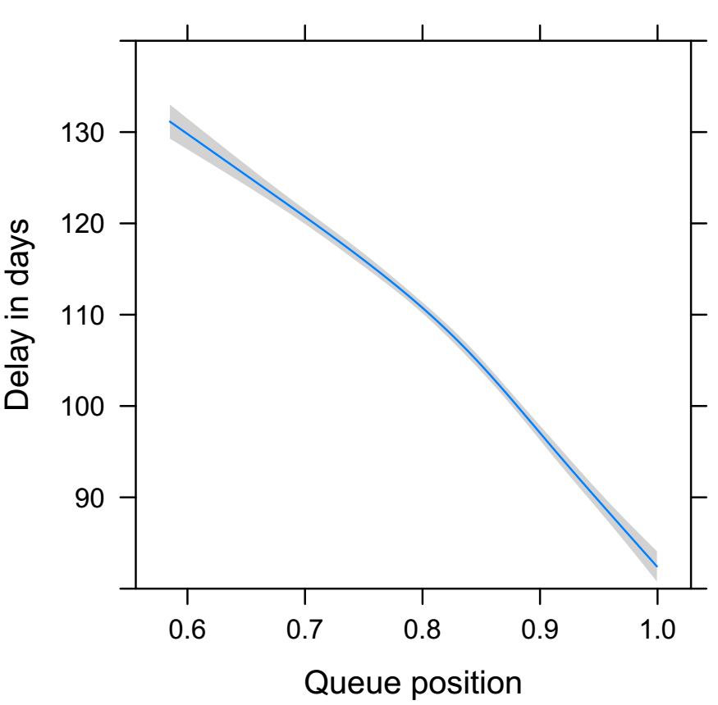
The time at which issues are addressed during a release cycle plays a major role in modeling delay in terms of days
RQ4 – What are the most influential factors for modeling delivery delay?
32

Slide 37
Empirical Study
Frequency
Explore factors
Prolonged delays
Indeed, delivery delay is frequent
Project factors are the most important
33

Slide 38
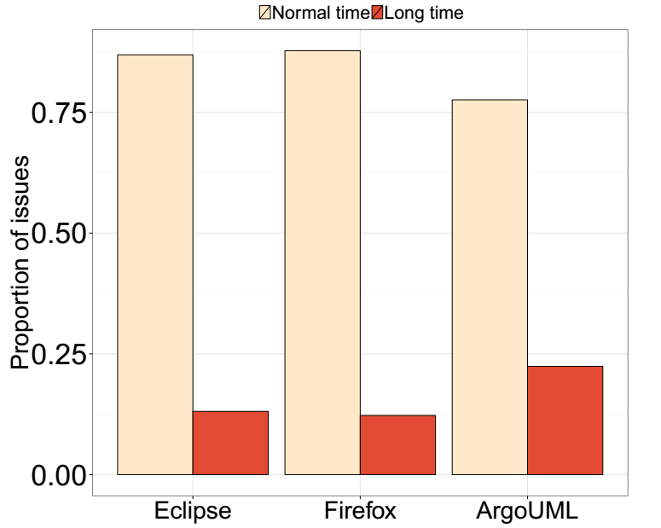
The proportion of issues that suffered from prolonged delays is under 25% for each dataset
RQ5 – How well can we identify issues that will suffer from a prolonged delay?
34

Slide 39
Our statistical models achieve a good fit
RQ5 – How well can we identify issues that will suffer from a prolonged delay?
AUCs
0.82 – 0.96
35

Slide 40
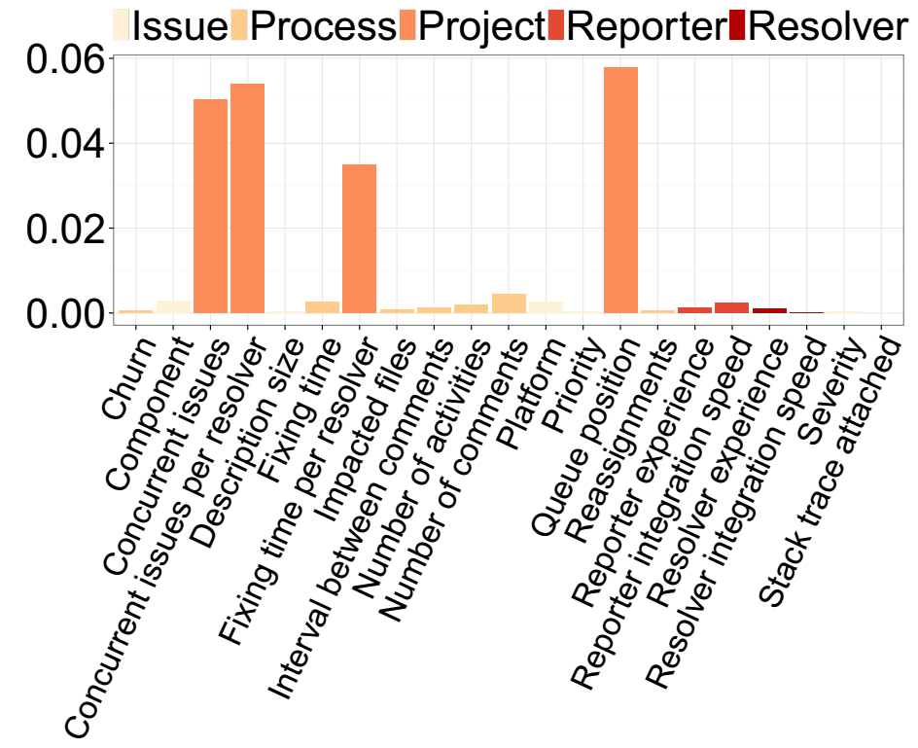
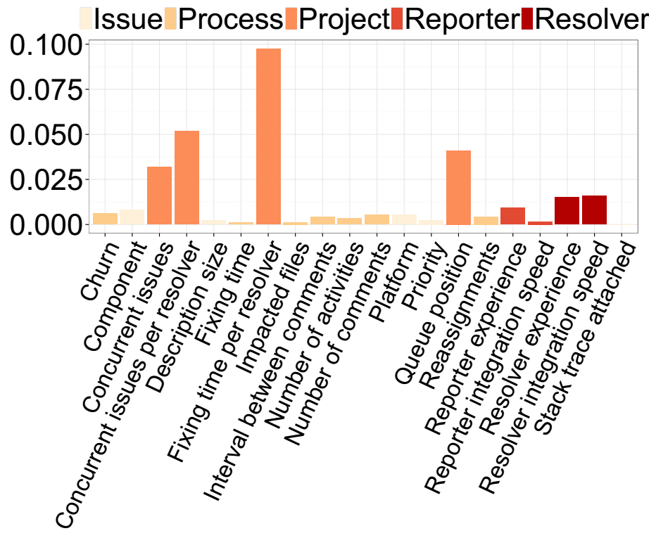
Project factors are most important to model prolonged delays
RQ6 – What are the most influential factors to model prolonged delays?
37

Slide 41

Delivery delays represent an overhead that development teams need to manage
Conclusions
39

Slide 42
Do rapid releases reduce delivery delays?
Study 2

Slide 43

The allure of delivering new features more quickly has led many projects to adopt rapid release cycles
Motivation
40

Slide 44
However, the speed at which features are delivered using rapid releases still needs to be empirically checked
Motivation
Uh oh… again,
no evidences…
41

Slide 45


We set out to empirically compare the delivery delay of traditional and rapid releases of the Firefox project
Empirical study
VS
Traditional
Rapid
111 releases
73 releases
34,673 issues
37,443 issues
1.0 to 4.0
10 to 27
42

Slide 46
We perform the following analyses
Empirical study
vs
3.6
3.6.1
3.6.2
Comparing delivery delays
Major vs minor releases
Analyzing important factors
43

Slide 47
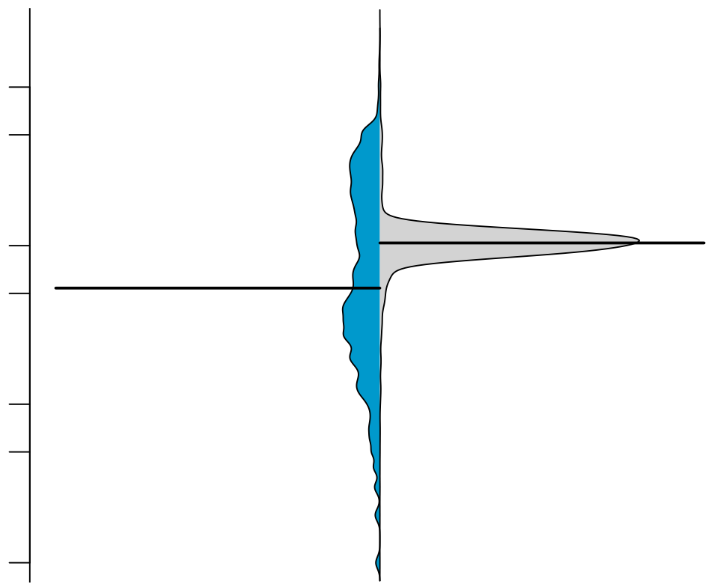
Although issues are fixed more quickly in rapid releases, they are delivered more slowly
RQ1 – Are addressed issues delivered more quickly in rapid releases?
500
Rapid
Traditional
50
Days to deliver fixed issues
5
1
44

Slide 48
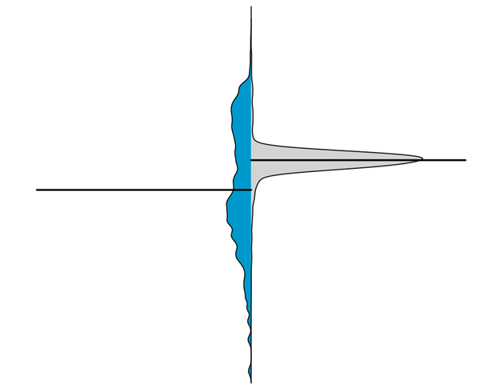


Fixed issues are delivered more consistently in rapid releases
RQ1 – Are addressed issues delivered more quickly in rapid releases?
I have consistent gains!
I can be faster!
Rapid
Traditional
45

Slide 49
Empirical study
vs
3.6
3.6.1
3.6.2
Comparing delivery delays
Major vs minor releases
Analyzing important factors
Rapid releases are not ‘that rapid’
46

Slide 50
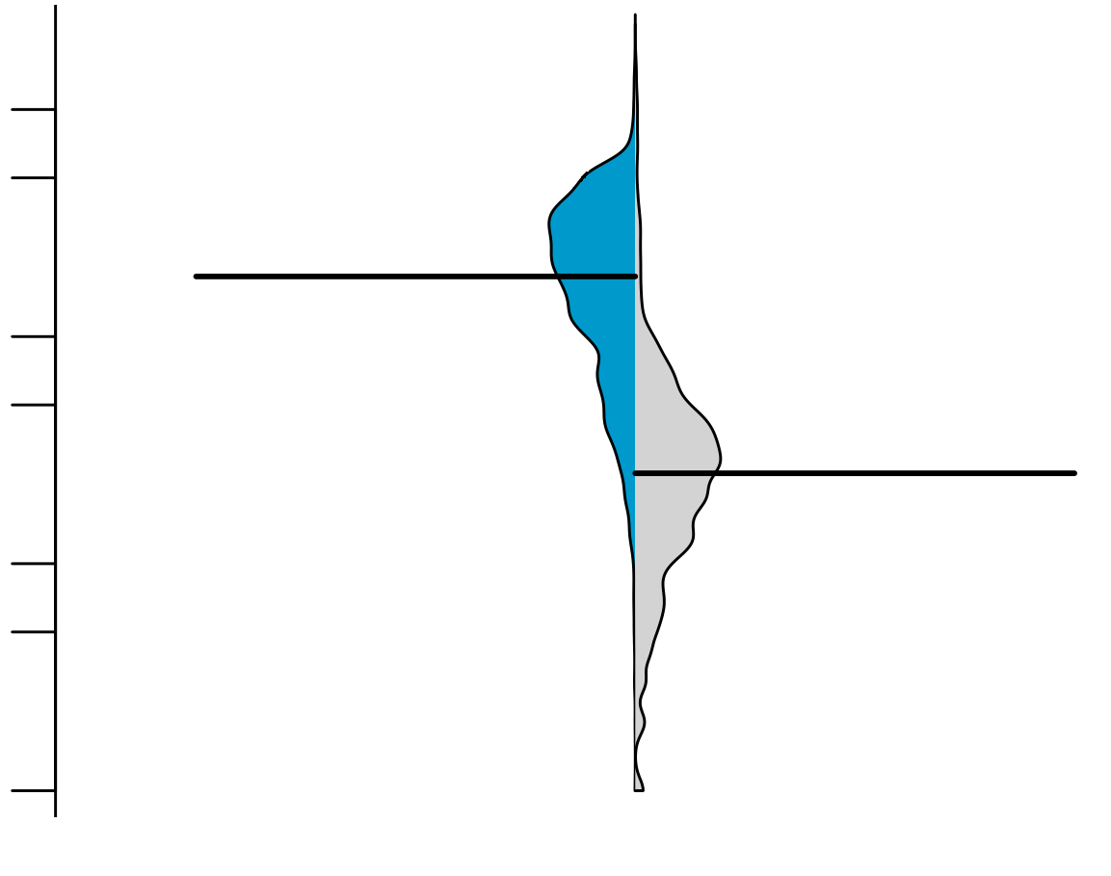
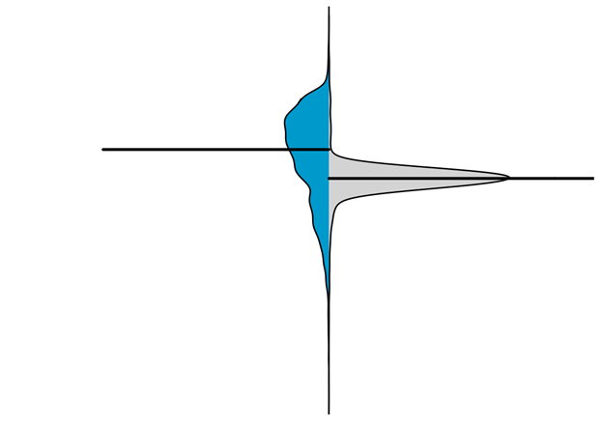
Minor releases: a key reason as to why traditional releases can deliver fixed issues more quickly
RQ2 – Why can traditional releases deliver addressed issues more quickly?
500
Major
traditional
Major
traditional
Rapid
Minor
traditional
50
Days to deliver fixed issues
5
1
47

Slide 51
Empirical study
vs
3.6
3.6.1
3.6.2
Comparing delivery delays
Major vs minor releases
Analyzing important factors
Rapid releases are not ‘that rapid’
Minor releases quicken the delivery time
49

Slide 52
As in Study 1, we collect several factors that we suspect to share a relationship with delivery delay
RQ3 – Does the release strategy have an impact on delivery delay factors?
50

Slide 53

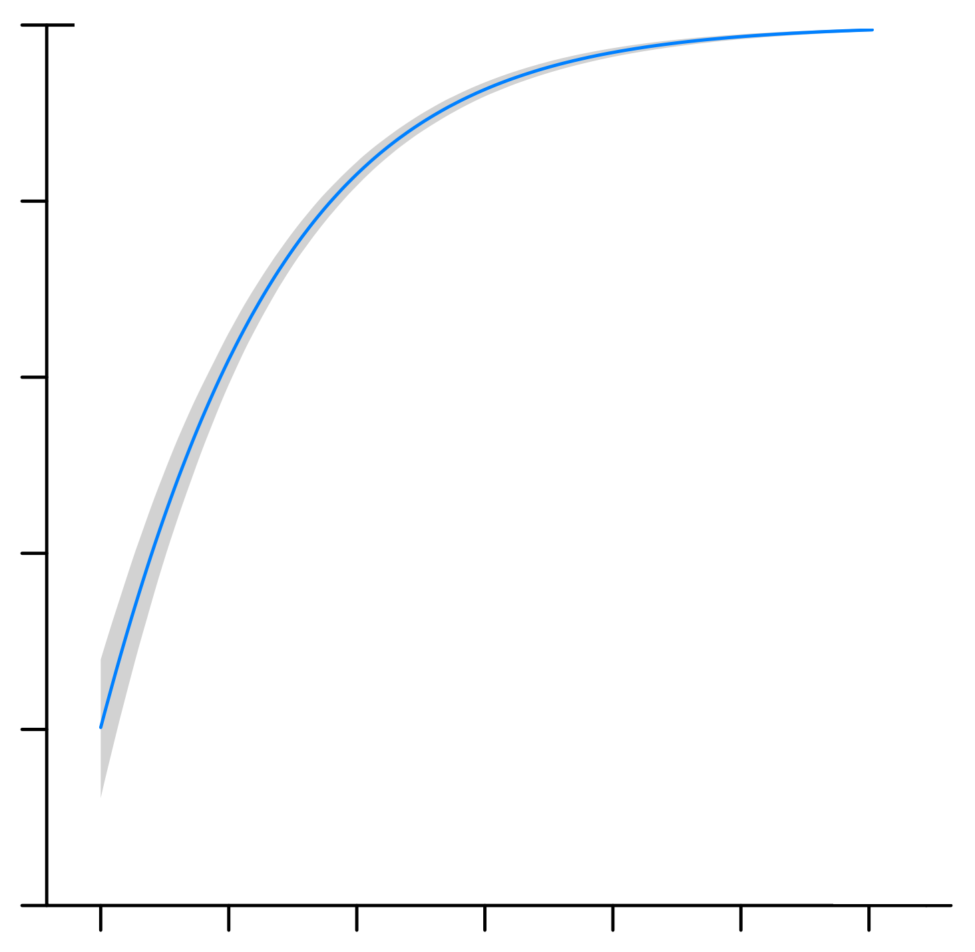
Prioritization is different among release strategies
RQ3 – Does the release strategy have an impact on delivery delay factors?
Position 4 in the backlog
0.95
2.0
3.0
0.90
0.85
0.80
Traditional
0
5,000
10,000
Position in the backlog
0.95
Position 2 in the cycle backlog
0.90
2.0
3.0
0.85
0.80
1,000
Rapid
0
3,000
Position in the cycle backlog
51

Slide 54
Traditional releases behave as a queue while rapid releases behave as a stack
RQ3 – Does the release strategy have an impact on delivery delay factors?
Released
Completed
1.0
2.0
3.0
VS
Released
Completed
3.0
2.0
1.0
52

Slide 55
Empirical study
vs
3.6
3.6.1
3.6.2
Comparing delivery delays
Major vs minor releases
Analyzing important factors
Rapid releases are not ‘that rapid’
Minor releases quicken the delivery time
Different prioritization
53

Slide 56

A rapid release strategy is not a silver bullet to reduce delivery delay
Conclusions
54

Slide 57
Why do Delivery Delays Occur?
Study 3

Slide 58

Reach deeper knowledge that was gained through quantitative analysis
Motivation
55

Slide 59

Verify to which extent our quantitative findings can be confirmed by our participants
Motivation
56
Notes:
Fazer uma reflexao no final atraves dos dois objetivos. Qual foi a vantage de ter usado o metodo qualitative?

Slide 60

We survey 37 participants from the Firefox, ArgoUML, and Eclipse projects
Empirical study
57
Notes:
We also perform 4 follow up interviews with participants that were willing to do so

Slide 61

We performs an extensive Open Coding analysis that generated 175 unique codes
Empirical study
58
Notes:
We also perform 4 follow up interviews with participants that were willing to do so

Slide 62



We perform the following analyses
Empirical study
General perceptions
Impressions about rapid releases
Do our findings make sense?
60
Notes:
Sempre interessante confrontar com os resultados quantitativos e qualitativos

Slide 63
The most recurrent themes are ‘development activities’, ‘decision making’, ‘risk’, ‘frustration’, and ‘team collaboration’
RQ1 – What are developers’ perceptions as to why delivery delay occur?
61

Slide 64
Additional testing is one of the main perceived reasons as to why delivery delay occurs
Development activities
Lack of “actual user testing beyond what QA can provide”
F17
61

Slide 65
Another main perceived reason is the workload
Development activities
“As the delayed completed issues stack up, they are harder to integrate (the codebase is constantly changing, merge issues might emerge)”
E30
62

Slide 66
The majority source of frustration is users’ ‘expectation’
Frustration
“as a user, it’s like when you are waiting your suitcase in the airport
to come out on the belt. You know it has to be there, but you keep waiting’’
F07
“it’s like a gift for Christmas, but the day of Christmas is postponed’’
F14
63

Slide 67
An overhead may be introduced when collaboration between teams is needed
Team collaboration
“sometimes, issues that require cross-team cooperation may be delayed when the issue is differently prioritized by each team.’’
F23
“generally happens when marketing wants to make a splash’’
F21
64

Slide 68
Empirical study
General perceptions
Impressions about rapid releases
Do our findings make sense?
Decision making, frustration, risk, external teams, dev. activities
65

Slide 69
The main themes about the impact of adopting rapid cycles can be grouped into: ‘management’, ‘delivery’, and ‘development’
RQ2 – What are developers’ perceptions of shifting to a rapid release cycle?
66

Slide 70
The most recurrent theme regarding management is ‘flexibility’
Management
“it is more flexible, since if an important issue pushed back a less important change and it misses the release cycle, it’s not a huge deal with rapid releases’’
F01
66

Slide 71
Another recurrent theme regarding management was ‘risk mitigation’
Management
“able to identify issues sooner. It is easier to identify issues when you have only deployed 3 new commits than 100’’
F07
66

Slide 72
By far, the most recurrent theme was the allure of ‘faster delivery’ of issues
Delivery
“increasing speed of getting new features to
users’’
F05
“getting new features to users sooner’’
F07
67

Slide 73
However, not all participants agree that rapid cycles deliver fixed issues faster
Delivery
“rapid releases reduce the time to deliver issues to end users in some cases, and lengthen them in others’’
F22
“Low priority issues (new features) take less time to be delivered, whereas high priority ones (important bugs) take more time’’
F24
68

Slide 74
‘Faster user feedback’ is another important theme regarding delivery
Delivery
“you don’t find yourself fixing a bug that you introduced two years ago which
the field only discovered on the release’’
E29
69

Slide 75
Empirical study
General perceptions
Impressions about rapid releases
Do our findings make sense?
Decision making, frustration, risk, external teams, dev. activities
Management, delivery, development activities
70

Slide 76
We request feedback about our two studied themes: reasons for delivery delay and impact of rapid releases
RQ3 – To what extent do developers agree with our quantitative findings?
71

Slide 77
We present our data that was obtained in Study 1
Reasons for delivery delay
71

Slide 78
The most recurrent theme cited by our participants was ‘workload’
Reasons for delivery delay
“committers are too busy’’
E27
“there might be delays in reviews when issues are completed’’
E26
72

Slide 79
We present our data that was obtained in Study 2
Impact of rapid release cycles
Rapid
Traditional
73

Slide 80
Five participants explicitly disagree with our obtained data
Impact of rapid release cycles
“I’m not surprised that there are things in that bucket. [Instead,] I’m surprised that there are many of them.”’
F06
74

Slide 81
Six participants explicitly agree with our obtained data
Impact of rapid release cycles
“since missing a release cycle isn’t a big deal, more features are kept from being released until they’re properly polished instead of being rushed at the end of a long release cycle”
F15
75

Slide 82
Empirical study
General perceptions
Impressions about rapid releases
Do our findings make sense?
Decision making, frustration, risk, external teams, dev. activities
Management, delivery, development activities
Our data helped us achieving deeper insights
76

Slide 83
Agenda
Thesis
Proposal
Background
Studies
Final Remarks
77

Slide 84

Limitations

Slide 85
Generalizability is hindered by the number of investigated systems
Study limitations
79

Slide 86
Lack of open datasets from projects that have transitioned from a traditional release strategy to a rapid release strategy
Study limitations
80

Slide 87
Small sample of participants in our qualitative analysis
Study limitations
81

Slide 88
Related Work

Slide 89

Will my patch make it?
Jiang 2013
83

Slide 90

Risk of postponing an upcoming release schedule
Morakot 2015
84

Slide 91
Conclusions

Slide 92
Even though issues are addressed, they may still suffer from delays that development teams need to manage
Conclusions
86

Slide 93
Rapid releases are not silver bullets to reduce delivery delays
Conclusions
87

Slide 94
Workload, limited tests, and lack of code reviews are main reasons as to why delivery delays may occur
Conclusions
88

Slide 95
Our qualitative analysis helped us to deepen our insights related to our quantitative analysis
Conclusions
89

Slide 96

Future Work
Notes:
Tool = conforme o codigo vai mudando e uma issue vai esperando, a integracao vai ficando mais complicada

Slide 97
Many possibilities for future research: replication, software quality, tooling, and prediction
Future work
91
Notes:
Tool = conforme o codigo vai mudando e uma issue vai esperando, a integracao vai ficando mais complicada

Slide 98
Summary

Slide 99
Study 1
Explore factors
Prolonged delays
Frequency
Explore factors
Frequency
Indeed, delivery delay is frequent
Project factors are the most important
Again… project factors are the most important

Slide 100
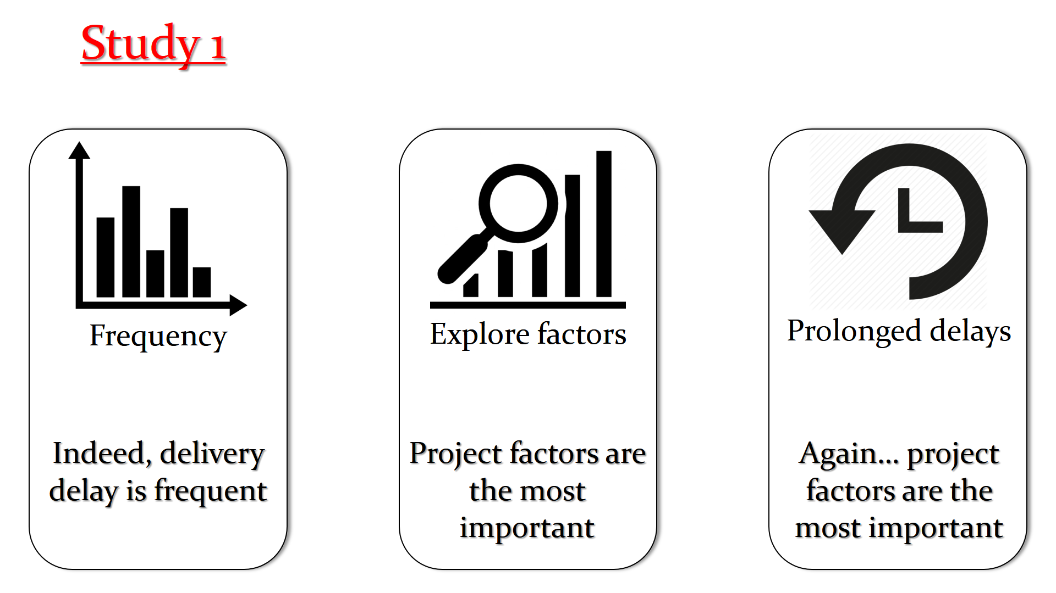

Slide 101
Study 2
vs
3.6
3.6.1
3.6.2
Comparing delivery delays
Major vs minor releases
Analyzing important factors
Rapid releases are not ‘that rapid’
Minor releases quicken the delivery time
Different prioritization

Slide 102
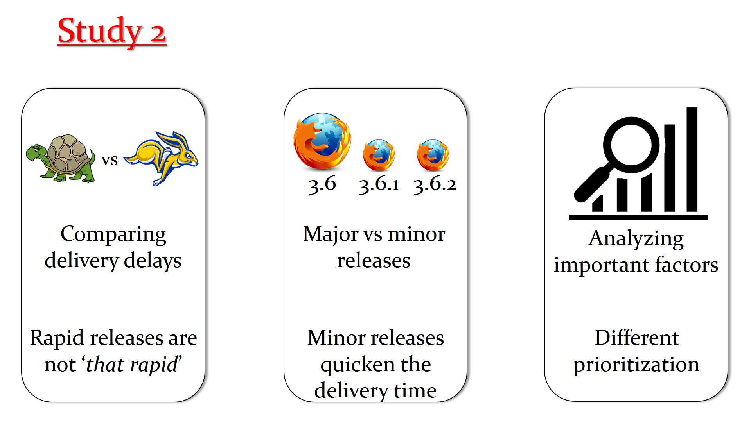

Slide 103
Study 3
General perceptions
Impressions about rapid releases
Do our findings make sense?
Decision making, frustration, risk, external teams, dev. activities
Management, delivery, development activities
Our data helped us achieving deeper insights

Slide 104
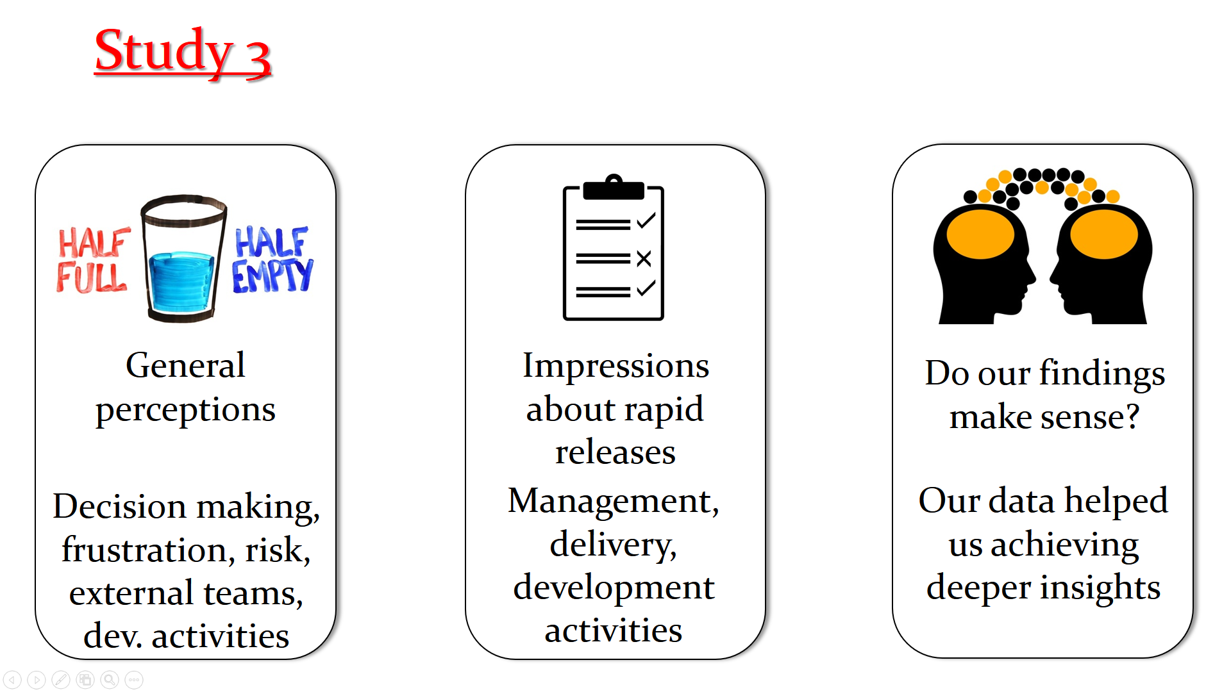

Slide 105
Thank you!

